Slide 1


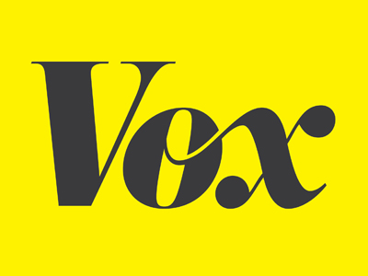


Ad Time Prediction

Slide 2
Project Problem
Vox Media launched a beta version of a new ad product for clients
Key performance indicator is viewability.
This new ad displays on screen and in-view for X seconds. I want to predict the optimum in-view time in seconds that will yield the highest viewability rate.
Is there is a strong correlation between in-view time and viewability? If not, which variable affects viewability most?
Currently, our product team has been toying with two numbers: 10 seconds and 12.5 seconds, and performing simple A/B testing. This project will help determine the optimum time for this new product.

Slide 3
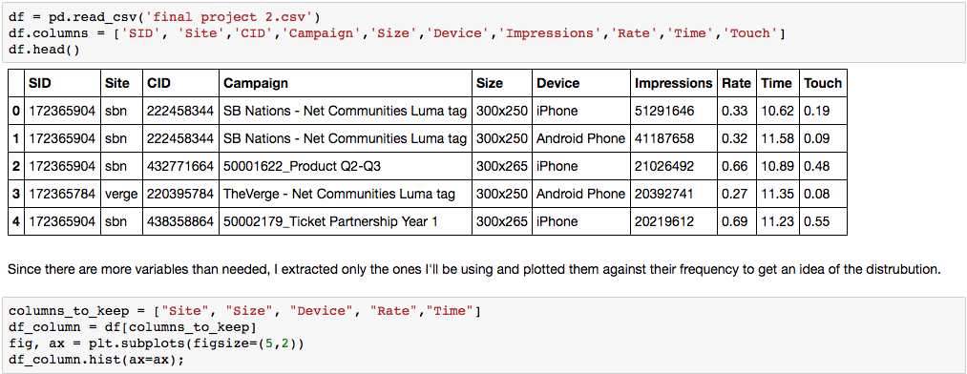
VARIABLES
Notes:
Since I have more variables than I need to build my model, I created a new columns to keep variable.
Create dummy variables for categorical columns – size, device, site

Slide 4
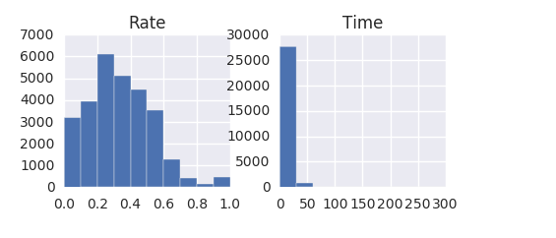
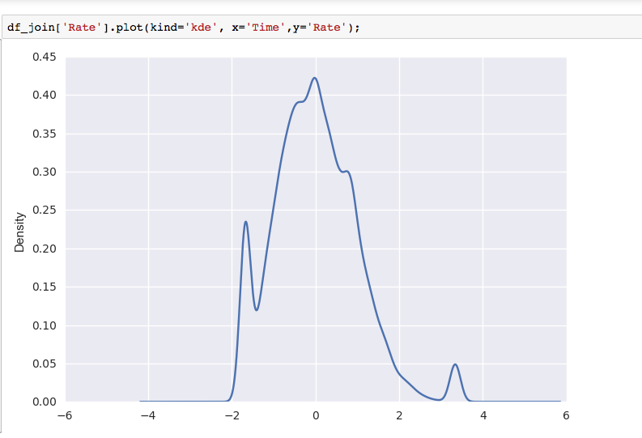
Distribution of Continuous Variables
Notes:
- Rate is skewed to the right
Time against rate looks to be normally distributed, with slight skewness to the right.

Slide 5
Project Concerns
Is there even a strong correlation between in-view time and viewability rate?
If not, which variable has the strongest correlation?
Does ad size matter (new beta ad is a 320x50).

Slide 6
Modeling
Used OLS, Ridge, and Lasso to train my model. Ride provided the lowest MSE of 0.879
Since I was so unable w/ my scoring, I performed GridSearchCV to further train my model and find optimal parameters.
As a way to further customize parameters settings, I ran a Random Forest Regressor.
Notes:
- Being so high andall and shows that I need to further train my model.

Slide 7
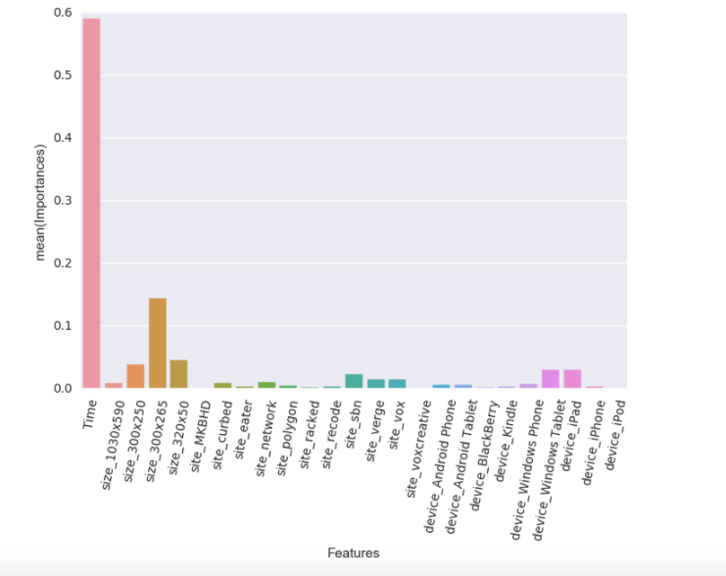
Feature Importance
Notes:
- This is a good sign! Time seems to be the most important feature compared to all other X values.

Slide 8
Prediction
Notes:
Not too many features which is why my scores were not the most ideal.
After training and tiring a few different modes, we arrived at an MSE of 0.67 which is better than the .87 I was seeing when I ran the OLS/Ridge/Lasso regression.

